Slide 1
Chapter 3 Data Representation

Slide 2

The girl I like is an old man?
Can you imagine that the person behind the voice is a stingy man when you hear such a cute voice? The voice changer function has become popular in major chatting platforms. Do you know that the principle of data conversion and processing is actually applied behind the scenes?

Slide 3
Number System and Representation
3.1
People usually use a decimal system for counting.
In contrast, digital devices use a binary system.

Slide 4
Unit of data
A
In a digital device, data is usually measured by the following units.
Unit | Symbol | Value
Bit | bit, b | The most basic unit of data. It can be either "0" or "1".
Byte | B | 1 B = 8 bits
Kilobyte | KB | 1 KB = 2¹⁰ B = 1024 B = 2¹⁰ B
Megabyte | MB | 1 MB = 2¹⁰ KB = 1024 KB = 2²⁰ B
Gigabyte | GB | 1 GB = 2¹⁰ MB = 1024 MB = 2³⁰ B

Slide 5
Unit of data
A
In a data transmission system, the amount of data transferred per unit time is called bitrate or data transfer rate:
Unit | Symbol | Value
Bit per second | bps, bit/s, b/s | One bit of data is transferred every second.
Kilobit per second | kbps, kbit/s, kb/s | 1 kbps = 10³ bps = 1000 bps = 10³ bps
Megabit per second | Mbps, Mbit/s, Mb/s | 1 Mbps = 10³ kbps = 1000 kbps = 10⁶ bps
Gigabit per second | Gbps, Gbit/s, Gb/s | 1 Gbps = 10³ Mbps = 1000 Mbps = 10⁹ bps
Terabit per second | Tbps, Tbit/s, Tb/s | 1 Tbps = 10³ Gbps = 1000 Gbps = 10¹² bps

Slide 6
Binary number
B
In data representation, binary numbers are used because each digit of a binary number can represent one bit of digital data.
Binary numbers are represented by “0” and “1” only.
Decimal number | 0 | 1 | 2 | 3 | 4 | 5 | 6 | 7
Binary number | 000 | 001 | 010 | 011 | 100 | 101 | 110 | 111

Slide 7
3.1
Conversion between binary numbers and decimal numbers
For a binary number, 1101₂ , we can convert it into a decimal number by expanding it like below.
Therefore, 1101₂ = 8 + 4 + 0 + 1 = 13₁₀ .
Digit | 1 | 0 | 0 | 1
Place value | 2³ = 8 | 2² = 4 | 2¹ = 2 | 2⁰ = 1
Value of the digit | 8 × 1 = 8 | 4 × 1 = 4 | 2 × 0 = 0 | 1 × 1 = 1

Slide 8
3.1
Convert 10110101₂ into a decimal number.
Therefore, 10110101₂ =
Digit | 1 | 0 | 1 | 1 | 0 | 1 | 0 | 1
Place value | 27 = 128 | 26 = 64 | 25 = 32 | 24 = 16 | 23 = 8 | 22 = 4 | 21 = 2 | 20 = 1
Value of the digit

Slide 9
3.1
Convert 10110101₂ into a decimal number.
Therefore, 10110101₂ = 128 + 0 + 32 + 16 + 0 + 4 + 0 + 1 = 181₁₀
Digit | 1 | 0 | 1 | 1 | 0 | 1 | 0 | 1
Place value | 27 = 128 | 26 = 64 | 25 = 32 | 24 = 16 | 23 = 8 | 22 = 4 | 21 = 2 | 20 = 1
Value of the digit | 128 × 1 = 128 | 64 × 0 = 0 | 32 × 1 = 32 | 16 × 1 = 16 | 8 × 0 = 0 | 4 × 1 = 4 | 2 × 0 = 0 | 1 × 1 = 1

Slide 10
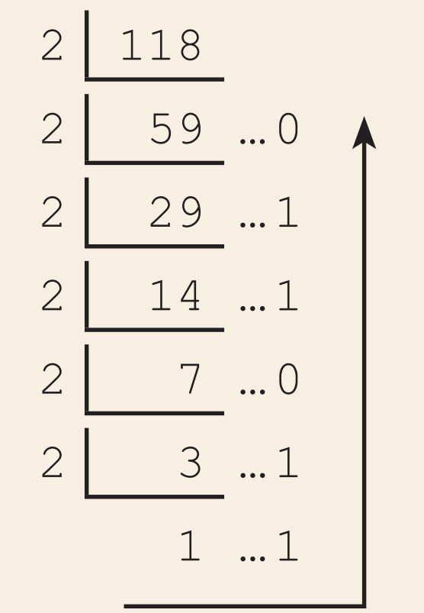
3.1
For a decimal number, 118₁₀ , we can convert it to a binary number by repeatedly dividing it by 2 until the quotient is smaller than 2, then arranging the quotient and the sequence of remainders from the last one to the first one. Therefore, 118₁₀ = 1110110₂ .

Slide 11
3.1
Convert 149₁₀ into a binary number. Therefore, 149₁₀ =

Slide 12
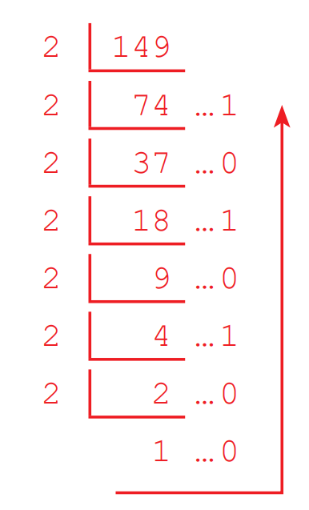
3.1
Convert 149₁₀ into a binary number. Therefore, 149₁₀ = 10010101₂

Slide 13
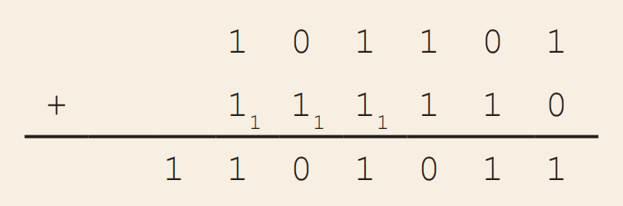
3.1
Calculation of binary numbers
Arithmetic operations on binary numbers are more or less the same as that of decimal numbers. Some calculators, including the built-in calculators in mobile phones, can calculate binary numbers.
Here is an example of calculating 101101₂ + 111110₂ .

Slide 14
3.1
Calculate 111011₂ + 1100101₂ .

Slide 15
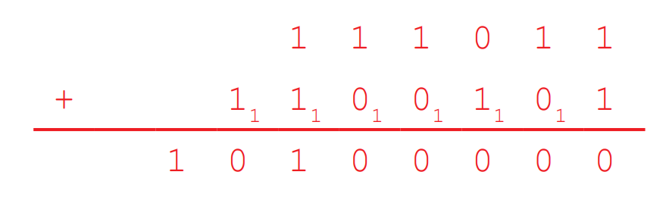
3.1
Calculate 111011₂ + 1100101₂ .

Slide 16
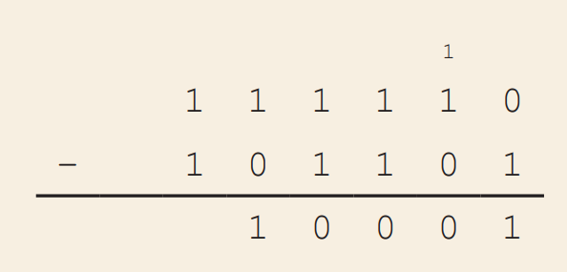
3.1
Here is an example of calculating 111110₂ − 101101₂ .

Slide 17
3.1
Calculate 1100101₂ − 111011₂ .

Slide 18
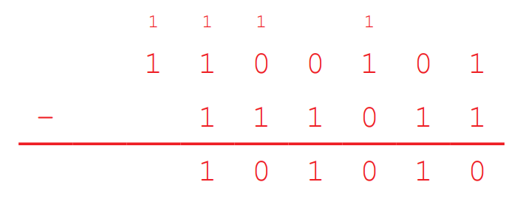
3.1
Calculate 1100101₂ − 111011₂ .

Slide 19
Binary number
B
The number of patterns (combinations) determines how much data can be represented.
For example, a 1-digit binary number is either 0 to 1, meaning that it has 2 unique patterns. A 3-digit binary number ranges from 0 to 7, meaning that it has 8 unique patterns.
1st pattern | 2nd pattern
0 | 1
1st pattern | 2nd pattern | 3rd pattern | 4th pattern | 5th pattern | 6th pattern | 7th pattern | 8th pattern
000 | 001 | 010 | 011 | 100 | 101 | 110 | 111

Slide 20
Hexadecimal number
C
A hexadecimal number is a number in base 16. Each digit can represent 4 bits of digital data, since 2⁴ = 16.
To represent 10 to 15 in a single digit, hexadecimal system uses A to F respectively.
 | The range of a digit
Binary number | 0 to 1
Decimal number | 0 to 9
Hexadecimal number | 0 to 9, A to F

Slide 21
3.2
Conversion between hexadecimal numbers and decimal numbers
For a hexadecimal number, B4AF₁₆ , we can convert it into a decimal number by expanding it like below. Therefore, B4AF₁₆ = 45056 + 1024 + 160 + 15 = 46255₁₀ .
Digit | B (11) | 4 | A (10) | F (15)
Place value | 16³ = 4096 | 16² = 256 | 16¹ = 16 | 16⁰ = 1
Value of the digit | 4096 × 11 = 45056 | 256 × 4 = 1024 | 16 × 10 = 160 | 1 × 15 = 15

Slide 22
3.2
Convert 9C7E₁₆ into a decimal number.
Therefore, 9C7E₁₆ = 36864 + 3072 + 112 + 14 = 40062_{10.}
Digit | 9 | C (12) | 7 | E (14)
Place value | 16³ = 4096 | 16² = 256 | 16¹ = 16 | 16⁰ = 1
Value of the digit | 4096 × 9 = 36864 | 256 × 12 = 3072 | 16 × 7 = 112 | 1 × 14 = 14

Slide 23
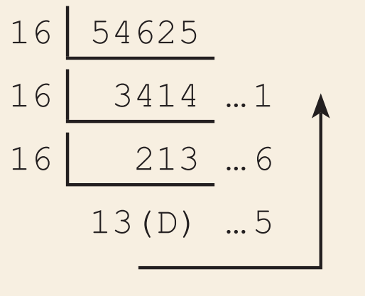
3.2
For a decimal number, 54625₁₀, we can convert it into a hexadecimal number by repeatedly dividing it by 16 until the quotient is smaller than 16, then arranging the quotient and the sequence of remainders from the last one to the first one. Therefore, 54625₁₀ = D561₁₆.

Slide 24
3.2
Convert 34604₁₀ into a hexadecimal number. Therefore, 34604₁₀ =

Slide 25
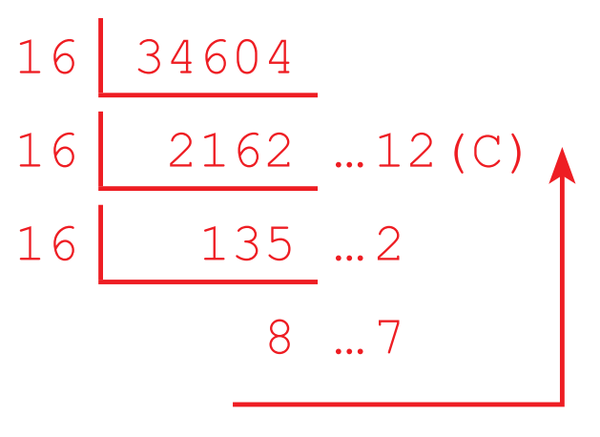
3.2
Convert 34604₁₀ into a hexadecimal number. Therefore, 34604₁₀ = 872C_{16.}

Slide 26
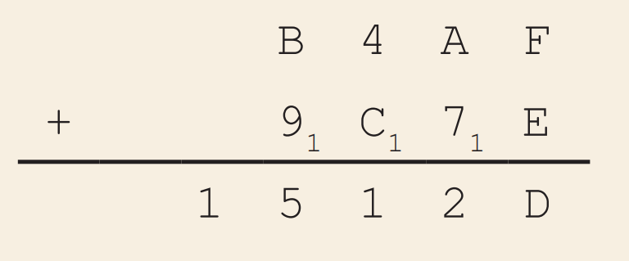
3.2
Calculation of hexadecimal numbers
Similarly, some calculators can calculate hexadecimal numbers too. Nevertheless, it is not difficult to calculate hexadecimal numbers by ourselves.
Here is an example of calculating B4AF₁₆ + 9C7E₁₆.

Slide 27
3.2
Calculate 6D61₁₆ + 972C₁₆.

Slide 28
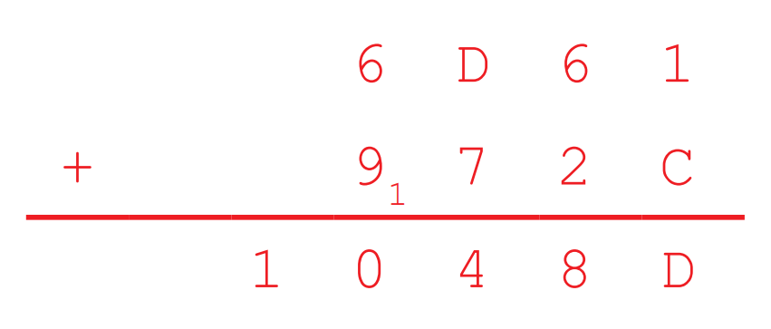
3.2
Calculate 6D61₁₆ + 972C₁₆.

Slide 29
3.2
Calculate 972C₁₆ − 6D61₁₆ .

Slide 30
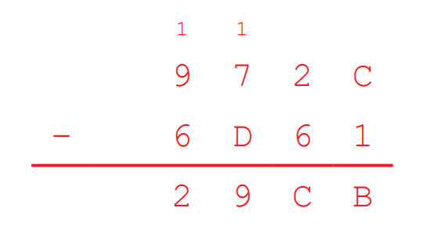
3.2
Calculate 972C₁₆ − 6D61₁₆ .

Slide 31
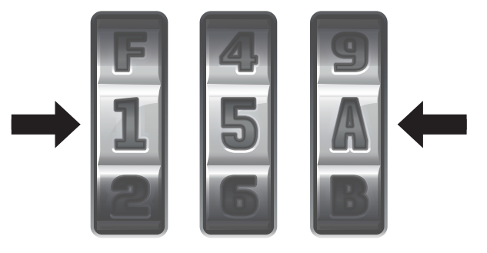
3.1
Here is a 3-digit combination lock. A digit can be 1 to 9 or A to F. The figure below shows this lock with a combination of "15A". How many different combinations does the password of this lock have?
3374
3375
4095
4096

Slide 32
3.1
Analysis
There are 15 possible symbols for each digit, since 0 is excluded. The number of combinations = 15 × 15 × 15 = 3375.
Solution
The answer is B.

Slide 33
3.1
Tom is the owner of a store. He wants to distribute 50,000 redeem codes for promotion. Each redeem code occupies 8 KB and is stored in a computer system. How many MB of storage space should Tom allocate for all redeem codes?
Analysis
The storage space Tom should allocate = 8 KB × 50,000 = 400,000 KB = (400,000 ÷ 1024) MB = 390.625 MB
Remember that you should convert 1024 KB, not 1000 KB, into 1 MB.
Solution
The answer is 390.625 MB. Rounding the result to the nearest integer is acceptable.

Slide 34
3.1
The computer system used by a school allocates 8 bits for a student identity number and 1 bit for the gender of a student. What is the maximum number of student accounts in the system?
64
128
256
512

Slide 35
3.1
Analysis
The maximum number of student accounts in the system depends on the maximum number of student identity numbers, as each student should have a unique student identity number.
The gender of a student is irrelevant. Two students of different genders cannot share the same student identity number.
Since 8 bits are allocated for a student identity number, the maximum number of student accounts equals to the number of possible patterns that an 8-bit representation has, i.e. 2⁸ = 256.
Solution
The answer is C.

Slide 36
3.1
Finish Checkpoint 3.1 on P. 67 of the textbook.
40 × 1024 × 1024 ÷ 500 ÷ 60 = 1398.1 hours. Rounding the result to the nearest hours is acceptable.
C
B

Slide 37
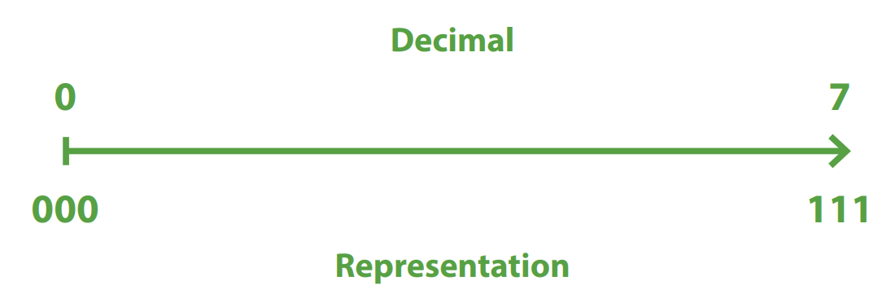
Representation of unsigned integers
D
When integers are stored in digital devices, they can be represented as unsigned integers or signed integers.
Unsigned integers are integers that do not have a negative sign, i.e. positive integers and zero.

Slide 38
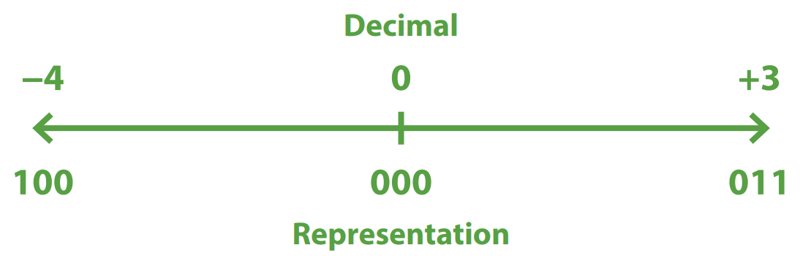
Representation of signed integers
E
Signed integers are integers that may have a negative sign, i.e. positive integers, negative integers and zero.

Slide 39
Representation of signed integers
E
The two’s complement representation is a method for representation of signed integers in bit pattern.
The two’s complement of a number is the result that comes from the negation of the number in twos complement representation, meaning that an integer −X can be represented by the two’s complement of X.
All 3-bit two’s complement representations are listed below.
Decimal number | -4 | -3 | -2 | -1 | 0 | 1 | 2 | 3
Two’s complement representation | 100 | 101 | 110 | 111 | 000 | 001 | 010 | 011

Slide 40
3.3
Conversion of two’s complement representations into decimal numbers
For a 3-bit two’s complement representation, 101 , we can convert it into a decimal number by expanding it like below. Therefore, 101₂ = -4 + 0 + 1 = -3₁₀.
Digit | 1 | 0 | 1
Place | -(2²) = -4 | 2¹ = 2 | 2⁰ = 1
Value of the digit | -4 × 1 = -4 | 2 × 0 = 0 | 1 × 1 = 1

Slide 41
3.3
For a 4-bit two’s complement representation, 0101 , we can convert it into a decimal number by expanding it like below. Therefore, 0101 = 4 + 0 + 1 = 5₁₀.
Digit | 0 | 1 | 0 | 1
Place | -(2³) = -8 | 2² = 4 | 2¹ = 2 | 2⁰ = 1
Value of the digit | -8 × 0 = 0 | 4 × 1 = 4 | 2 × 0 = 0 | 1 × 1 = 1

Slide 42
3.3
Convert a 4-bit two’s complement representation, 1010, into a decimal number. Therefore, 1010 =
Digit | 0 | 1 | 0 | 1
Place value | -(2³) = -8 | 2² = 4 | 2¹ = 2 | 2⁰ = 1
Value of the digit

Slide 43
3.3
Convert a 4-bit two’s complement representation, 1010, into a decimal number. Therefore, 1010 = -8 + 0 + 2 + 0 = -6₁₀
Digit | 0 | 1 | 0 | 1
Place value | -(2³) = -8 | 2² = 4 | 2¹ = 2 | 2⁰ = 1
Value of the digit | -8 × 1 = -8 | 4 × 0 = 0 | 2 × 1 = 2 | 1 × 0 = 0

Slide 44
3.3
Convert a 5-bit two’s complement representation, 10101, into a decimal number. Therefore, 10101 =
Digit | 1 | 0 | 1 | 0 | 1
Place value | -(2⁴) = -16 | 2³ = 8 | 2² = 4 | 2¹ = 2 | 2⁰ = 1
Value of the digit

Slide 45
3.3
Convert a 5-bit two’s complement representation, 10101, into a decimal number. Therefore, 10101 = −16 + 0 + 4 + 0 + 1 = −11₁₀
Digit | 1 | 0 | 1 | 0 | 1
Place value | -(2⁴) = -16 | 2³ = 8 | 2² = 4 | 2¹ = 2 | 2⁰ = 1
Value of the digit | -16 × 1 = -16 | 8 × 0 = 0 | 4 × 1 = 4 | 2 × 0 = 0 | 1 × 1 = 1

Slide 46


The two’s complement of 3₁₀ is 011, which is also the two’s complement representation of 3₁₀
The two’s complement of 3₁₀ is 101, which is also the two’s complement representation of -3₁₀. In short, the two’s complement of an integer X is the two’s complement representation of −X. Pay attention to the word “representation”.

Slide 47
Representation of signed integers
E
As we can see from the above table, the two’s complement of 1₁₀ is 111, which is the two’s complement representation of −1₁₀ .
Decimal number | -4 | -3 | -2 | -1 | 0 | 1 | 2 | 3 | 4
Two’s complement representation | 100 | 110 | 110 | 111 | 000 | 001 | 010 | 011 | Out of range
Two’s complement | Out of range | 011 | 010 | 001 | 000 | 111 | 110 | 101 | 100

Slide 48
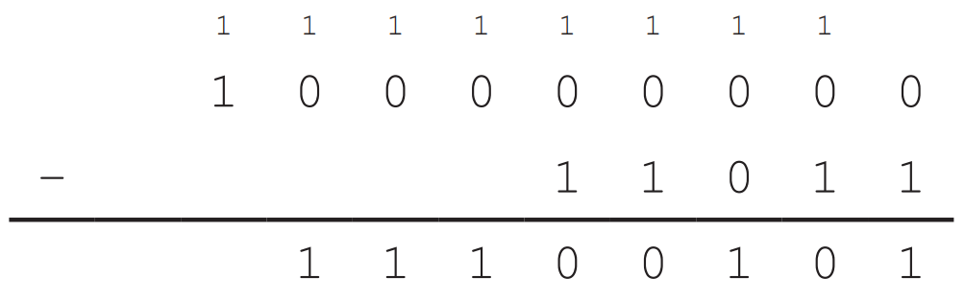
Representation of signed integers
E
The two’s complement of a binary integer can be found by subtraction from 2^{N}. For example, to find the 8-bit two’s complement of 27₁₀ , we can:
Convert 27₁₀ into a binary number, which is 11011. Add leading 0s to change it to an 8-bit binary representation, i.e. 0001 1011₂ .
Subtract it from 2⁸, i.e. 1 0000 0000. The 8-bit two’s complement of 27₁₀ is 1110 0101, which is the 8-bit two’s complement representation of −27₁₀ .

Slide 49
Representation of signed integers
E
The two’s complement of a binary integer can also be found by adding 1 to its one’s complement.
The one’s complement of a binary representation is produced by inverting all its bits, i.e. change 0 to 1 and 1 to 0.

Slide 50
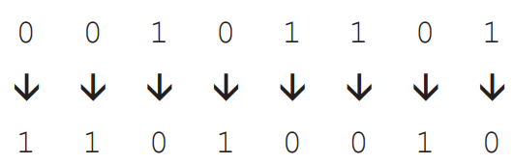
Representation of signed integers
E
For example, to find the 8-bit two’s complement of 45₁₀ , we can:
Convert 45₁₀ into a binary number, which is 101101. Add leading 0s to change it to an 8-bit binary representation, i.e. 0010 1101.
Invert all bits of the 8-bit representation.
Add 1 to the one’s complement and we get 1101 0011. The 8-bit two’s complement of 45₁₀ is 1101 0011, which is the 8-bit two’s complement representation of −45₁₀ .

Slide 51
3.2
What is the decimal value of the 4-bit two’s complement representation 1000?
0
-8
-15
-16

Slide 52
3.2
What is the 7-bit two’s complement of the decimal value 17?
001 0001
001 0010
110 1110
110 1111

Slide 53
3.2
What is the 8-bit two’s complement representation of the decimal value −1?
0000 0001
1000 0001
1111 1110
1111 1111

Slide 54
3.2
What is the decimal value of the 4-bit two’s complement representation 1000?
1001
11 0111
0001 0111
(1) only
(2) only
(1) and (3) only
(2) and (3) only

Slide 55
3.2
What is the decimal result of adding these two 8-bit two’s complement representations, 0110 and 1011?
-15
-1
1
17

Slide 56
Overflow error
F
An overflow error occurs when the result of a calculation is out of range that the number of bits can represent. In such cases, the results will be incorrect.

Slide 57
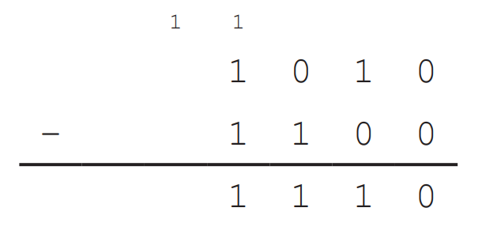
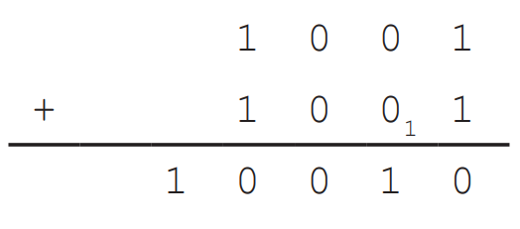
Overflow error
F
For unsigned integers, overflow error occurs during:
Addition | Subtraction
9₁₀ + 9₁₀ = 1001 + 1001 | 10₁₀ − 12₁₀ = 10₁₀ − 12₁₀ = 1010 − 1100

Slide 58
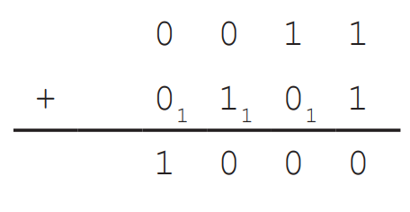
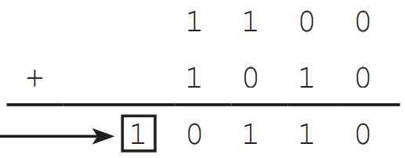

Overflow error
F
For signed integers, overflow error occurs during:
Addition | Subtraction
3₁₀ + 5₁₀ = 0011 + 0101 | −4₁₀ − 6₁₀ = −4₁₀ + (−6₁₀) = 1100 + 1010

Slide 59
When an additional bit appears after the calculation of two’s complement representations, an overflow error occurs.
When an additional bit appears after the calculation of two’s complement representations, it does not necessarily mean that an overflow occurs. The additional bit implies an overflow error only if it is a calculation of unsigned integer. The fundamental reason for overflow error is that the calculation result is out of range.

Slide 60
3.3
A computer uses 4-bit two’s complement representation to store integers. Which of the following calculations involves an overflow error?
2 − 3 + 4 − 2
3 + 4 + 2 − 2
2 + 3 − 4 − 2
−2 − 3 – 3

Slide 61
3.3
Analysis
The range of a 4-bit two’s complement representation is from −24−1 to 24−1−1, i.e. from −8 to 7.
For option A, 2 − 3 + 4 − 2 = −1 + 4 − 2 = 3 − 2 = 1. No result is out of range.
For option B, 3 + 4 + 2 − 2 = 7 + 2 − 2 = 9 − 2 = 7. Although the final result is not out of range, a number which is out of range appears in the calculation, meaning that an overflow error occurs during the calculation.
For option C, 2 + 3 − 4 − 2 = 5 − 4 − 2 = 1 − 2 = −1. No result is out of range.
For option D, −2 − 3 − 3 = −5 − 3 = −8. No result is out of range.
Only option B involves an overflow error.
Solution
The answer is B.

Slide 62
3.3
Jane’s computer uses 8-bit two’s complement representation to store numbers. She increments a number X by 3, then an overflow error occurs. What is the number X?
0111 1110
1111 1110
0000 1101
1000 0000

Slide 63
3.3
Analysis
3 is a positive number. Overflow error occurs only if two numbers of the same sign are added together.
The representations of option B and D both represent a negative number. Therefore, option B and D cannot be the answer.
The 8-bit two’s complement representation of 3 is 0000 0011.
For option A, 0111 1110 represents a positive number. 0111 1110 + 0000 0011 = 1000 0001, which represents a negative number.
For option C, 0000 1101 represents a positive number. 0000 1101 + 0000 0011 = 0001 0000, which represents a positive number.
Solution
The answer is A.

Slide 64
3.3
A computer performs this calculation, P + Q, and returns R as the answer. Assume that P, Q and R are all 3-bit unsigned integers, under what conditions would an overflow error occur during this calculation?
P = 7
P > R
P > 3 and Q > 4
(1) and (2) only
(1) and (3) only
(2) and (3) only
(1), (2) and (3)

Slide 65
3.3
Analysis
For item (1), if Q = 0, then P + Q = 7, which is NOT out of the range of a 3-bit unsigned integer.
For item (2), since P, Q and R are all unsigned integers, they can only be zero or positive. Adding zero or a positive integer to P should result in an integer larger than P.
For item (3), if P > 3 and Q > 4, then P + Q > 7. A 3-bit unsigned integer cannot be larger than 7.
Solution
The answer is C.

Slide 66
3.3
Finish Checkpoint 3.3 on P. 81 of the textbook.
A
B
D
C

Slide 67
Character Encoding
3.2
Besides numbers, there are also representation methods for characters.
They are called character encoding systems. Text in different languages may use different encoding systems.

Slide 68
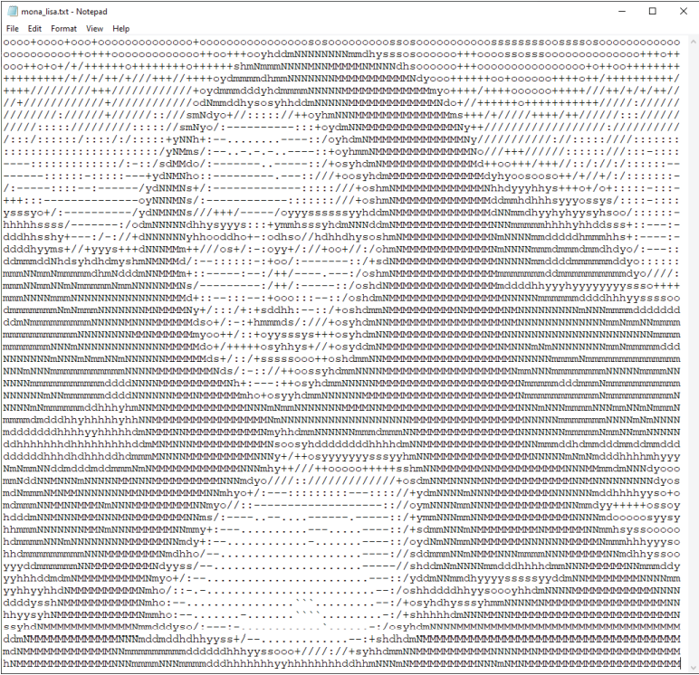
English
A
American Standard Code for Information Interchange (ASCII) is one of the commonly used character encoding systems for English.
ASCII usually uses 7 bits to represent a character. Thus, it can represent 2⁷ = 128 characters.
See P. 83 of the textbook for the ASCII table.

Slide 69
Chinese
B
There are two sets of Chinese characters:
Traditional Chinese, which is often encoded by Big-5 code.
Simplified Chinese, which is often encoded by Guobiao (GB) code.

Slide 70
Chinese
B
Both encoding systems represent Chinese, but they are not interchangeable.
Code (in hexadecimal representation) | BD73 | BD58 | A874 | B2CE | B1E0 | C2EB | CFB5 | CDB3
Character in Big-5 code | 編 | 碼 | 系 | 統 | 晤 | 鎢 | 炵 | 苀
Character in Guobiao (GB) code | 絪 | 絏 | ╰ | 参 | 编 | 码 | 系 | 统

Slide 71
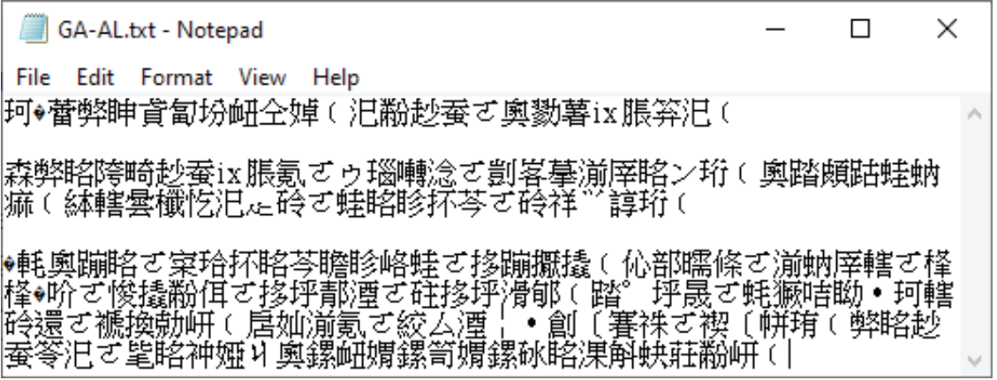
Chinese
B
If a text file or a website is encoded by Big-5 code, but is decoded by Guobiao code, instead of being translated to simplified Chinese, the text will be displayed as garbled text.

Slide 72
Multi-languages
C
A character encoding system named Unicode is used to represent multiple languages.
Unicode is made for representing all the existing languages, like Korean, Arabic, Thai, Russian, etc.
Code (in hexadecimal representation) | 7DE8 | 78DC | 7CFB | 7D71 | 7F16 | 7801 | 7CFB | 7EDF
Character in Unicode | 編 | 碼 | 系 | 統 | 编 | 码 | 系 | 统

Slide 73
Multi-languages
C
Due to the enormous number of Unicode characters, Unicode may use up to 4 bytes to represent a character.
It uses variable-width encoding, which allows codes of different lengths to be used to encode different characters.
Unicode characters may take 1 to 4 bytes, depending on the languages.
Language | Character encoding system | Size per character
English | ASCII | 7 bits to 1 byte
Traditional Chinese | Big-5 code | 2 bytes
Simplified Chinese | Guobiao (GB) code
Most languages in the world | Unicode | 1 to 4 bytes

Slide 74
3.4
Which of the following statements about Unicode, ASCII and Big-5 code is/are correct?
Among the three character encoding systems, ASCII has the smallest size of character set.
Big-5 code does not support English letters.
Unicode uses 4 bytes to store every character.
(1) only
(2) only
(1) and (3) only
(2) and (3) only

Slide 75
3.4
Analysis
ASCII does not support languages other than English. Big-5 code supports English and traditional Chinese characters. Unicode supports more than one language. Therefore, (1) is correct and (2) is incorrect.
Unicode uses variable-width encoding, which allows codes of different lengths to be used to encode different characters. The size of a Unicode character varies from 1 to 4 bytes. Thus, (3) is incorrect.
Solution
The answer is A.

Slide 76
3.4
A device uses 8 bits to store an integer and 16 bits to store a character. To store the text string “3D printer”, how many bytes are needed?
17 bytes
18 bytes
19 bytes
20 bytes

Slide 77
3.4
Analysis
“3D printer” is a text string, meaning that it consists of characters. The “3” in “3D printer” is a numeric character, not an integer, and thus it occupies 16 bits instead of 8 bits. The whitespace after “3D” still counts as a character.
As a result, there are 10 characters in the text string, occupying 16 × 10 bits = 160 bits = 20 bytes in total.
Solution
The answer is D.

Slide 78
3.4
A device uses a hexadecimal code, ranging from 000 to FFF, to store a character. How many bytes are required to represent a text string of 6 characters?
Analysis
Every digit in a hexadecimal code equals to 4 bits, as 24 = 16. Therefore, a 3-digit hexadecimal code takes 4 × 3 bits = 12 bits. 6 characters takes 12 × 6 bits = 72 bits = 72 ÷ 8 bytes = 9 bytes.
Solution
12 × 6 ÷ 8 = 9 bytes

Slide 79
3.4
Finish Checkpoint 3.4 on P. 87 of the textbook.
(a) Unicode. The data includes English, traditional and simplified Chinese. All three languages are supported by Unicode.
(b) Any reasonable answer, such as Japanese, Arabic, Thai, Russian, etc.
Advantage: Unicode supports more languages. It can represent both traditional and simplified Chinese characters. Disadvantage: Unicode requires more storage space than Big-5 code does.

Slide 80

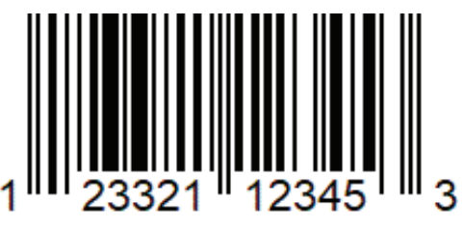
Barcode Encoding
3.3
Can you give an example of where you have seen the following two images?

Slide 81
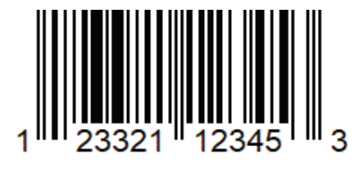
Barcode
A
Barcode is widely used in our daily life. It can be seen on a packaged product sold in supermarkets or a coupon distributed by retailers.

Slide 82
Barcode
A
Barcodes are codes that consist of bars and spaces of different widths to represent a text string. This string is often a sequence of numbers representing a product ID.
Compared with manually typing the numbers, barcode scanning reduces typing errors and input time.

Slide 83
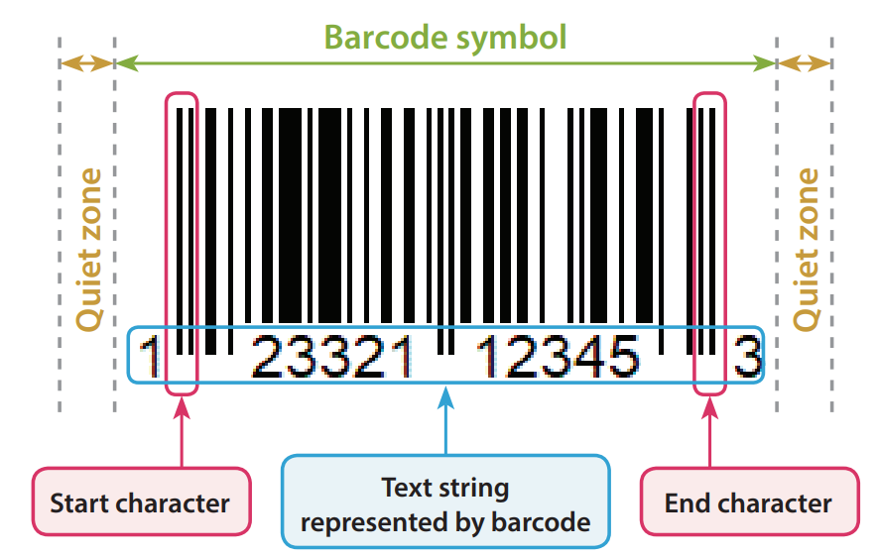
Barcode
A
Here are the elements of a barcode.

Slide 84
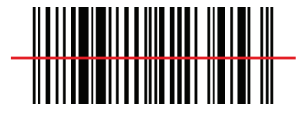

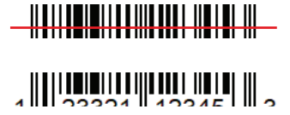
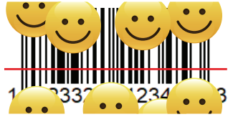
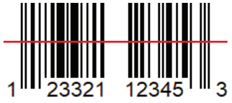
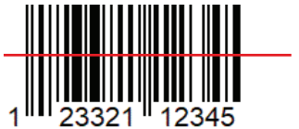
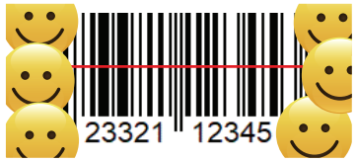
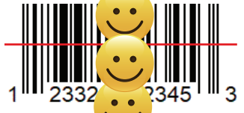
Barcode
A
The heights of the bars do not matter in a barcode. It is the widths of the bars and spaces that matter.
A readable barcode must:
Have sufficient space for the quiet zone
Keep the widths of its bars and spaces unchanged
Readable barcode
Unreadable barcode

Slide 85
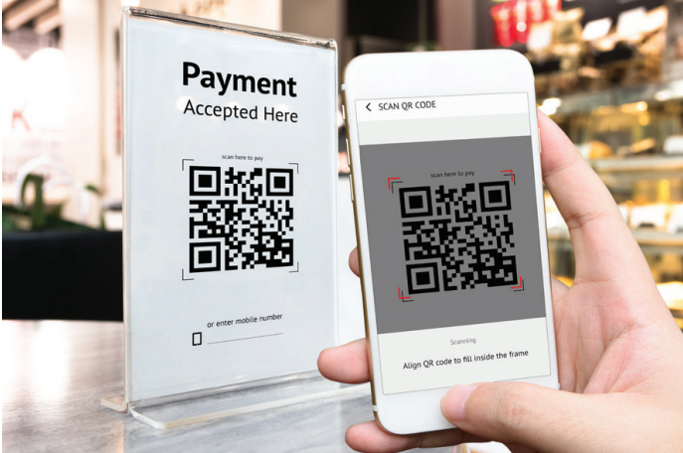
Quick Response code
B
Quick Response code (QR code) is a two-dimensional barcode. It can be seen on various posters, books, websites, applications, etc.

Slide 86
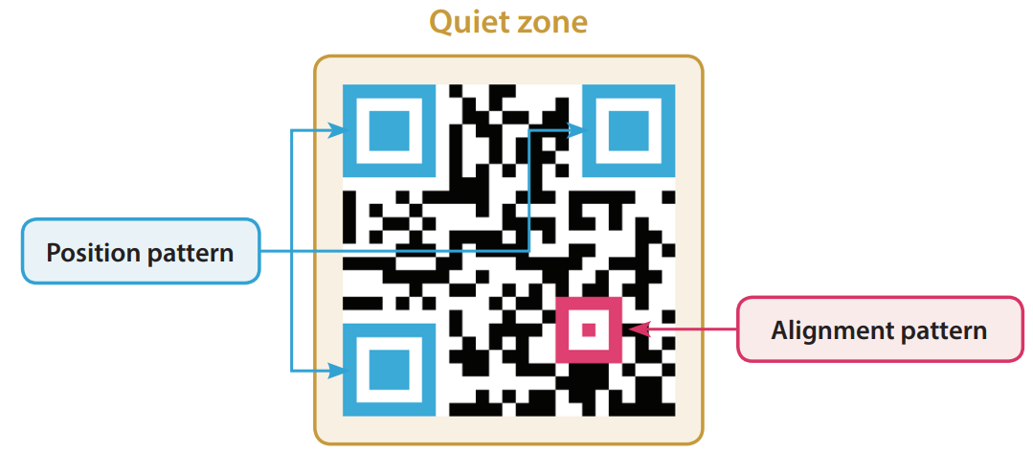
Quick Response code
B
A QR code is made up of numerous black dots arranged in a white square background. It represents a text string which is usually a Uniform Resource Locator (URL), a phone number or an email address.
Here are the elements of a QR code.

Slide 87






Quick Response code
B
QR codes can be still be scanned in different scenarios:
Rotated | Distorted | Dirtied
Coloured | Multicoloured | Obstructed by a logo

Slide 88
Quick Response code
B
QR codes are becoming more and more popular due to their advantages over barcode. Refer to the comparison below.
Attribute | Barcode | QR code
Easiness to scan | Normally, a barcode can only be scanned from two angles, which are 0° or 180°. | A QR code can be scanned from any direction. Even if the scanner is at an angle that distorts the scanned image, it still has a chance to read the QR code successfully.
Error correction capability | If the width of a single bar or a single space is altered, a barcode cannot be scanned correctly. | A QR code has a higher error correction capability than a barcode. It can often restore up to 30% of data.
Character limit | The maximum length of the number sequence is around 50. | Usually, the character limit of the text string is at least 1000.

Slide 89

3.5
Which of the following statements about the barcode below is/are correct?
This type of barcode cannot represent a number.
This type of barcode can be scanned in any direction.
This type of barcode may be decoded even if a logo is added to its centre.
(1) only
(2) only
(1) and (3) only
(2) and (3) only

Slide 90
3.5
Analysis
This type of barcode is a QR code. QR codes can represent any type of characters. Thus, (1) is incorrect. A QR code has three position patterns, allowing it to be scanned from any direction. Thus, (2) is correct. A QR code can restore up to 30% of data. Thus, (3) is correct.
Solution
The answer is D.

Slide 91
3.5
Ben is a shop owner. Every product in his shop has a barcode on its package paper. When a product is bought, the cashier will scan the barcode using a barcode reader to update the number of products in stock.
What does the barcode represent?
A number (a sequence of numbers) (product ID)
Give two benefits of this method.
Reduces typing errors and input time.

Slide 92
Analog and Digital Data
3.4
There are different ways to represent a piece of data:
Analog data is represented in a physical way with continuous values, such as sound waves, written text and drawings.
Digital data is represented in discrete symbols (like “0” and “1”), such as text documents, digital photos and audio files.

Slide 93
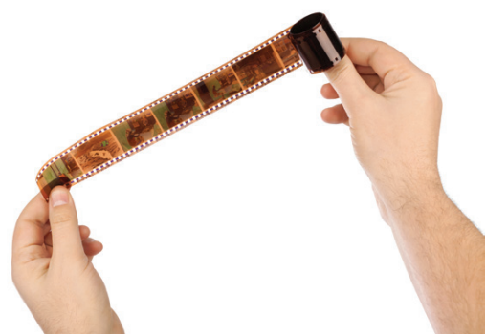
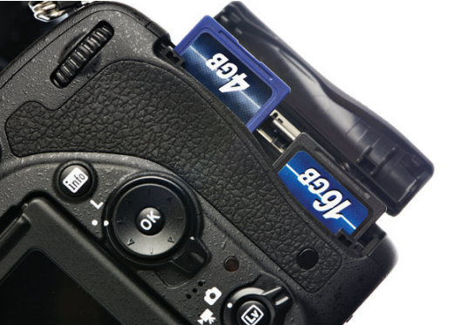
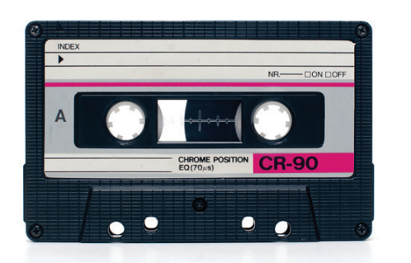
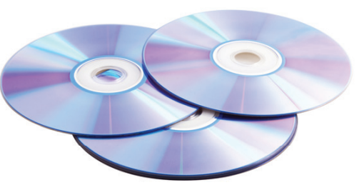
Analog and Digital Data
3.4
Analog data and digital data are stored in different kinds of storage media.
Analog data storage | Digital data storage

Slide 94
Analog and Digital Data
3.4
See the following table for a comparison between analog and digital data.
Attribute | Analog data | Digital data
Way of representation | Physical. The change between its values is continuous. | Discrete symbols. Usually, the symbols are "0" and "1" in digital devices.
Viability to reduce storage size by compression | Low. | High. Digital television signals occupy less radio spectrum.
Capability of data analysis | Low. Calculation results written on a ledger needs to be updated manually when relevant data is changed. | High. An electronic spreadsheet can update data automatically when relevant data is changed and even create charts in no time.

Slide 95
Digitalisation
A
Digitalisation is the conversion of analog data to digital data.
We can break down digitalisation into two parts:
Discretisation
Quantisation

Slide 96
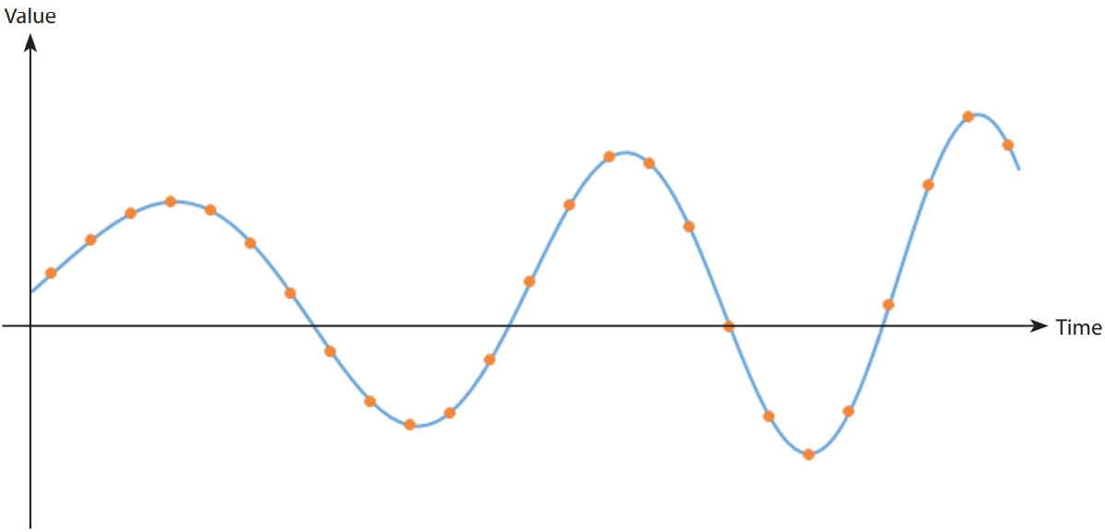
Digitalisation
A
To convert an analog signal into a digital signal, the value of the signal should be sampled at a regular time interval. The length of this time interval determines the sampling rate. This process is called “discretisation”.

Slide 97
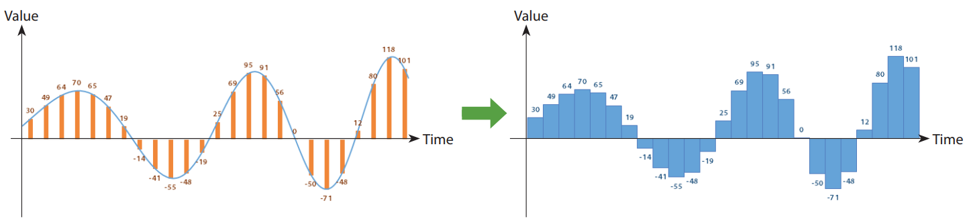
Digitalisation
A
Sampled values are rounded to a fixed set of discrete values, which is usually represented by binary numbers in digital storage. This process is called “quantisation”.

Slide 98
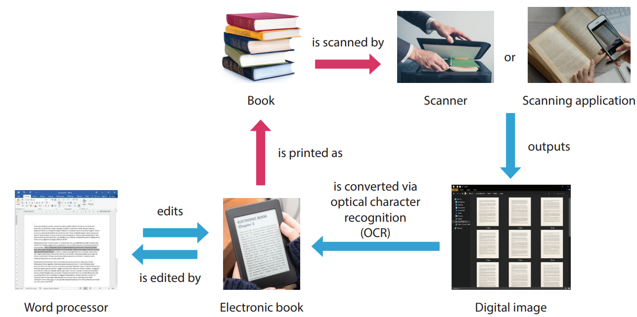
Digitalisation
A
Converting physical books to electronic books is usually a digitalisation of text and images.

Slide 99
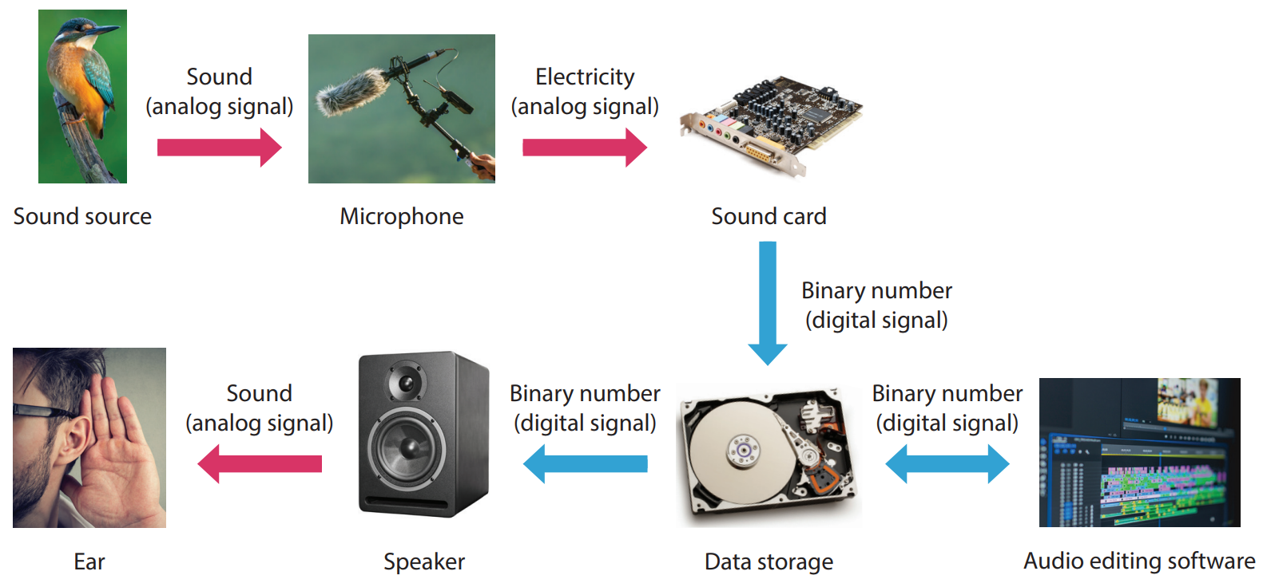
Digitalisation
A
Sound waves are analog data that can be converted into digital data through the following process:

Slide 100
3.6
Which of the following actions involve data conversion between analog data and digital data?
Printing an electronic document
Combining multiple image files into a video file
Recording the sound of a fox
(1) and (2) only
(1) and (3) only
(2) and (3) only
(1), (2) and (3)

Slide 101
3.6
Analysis
For item (1), an electronic document is digital data while a printed document is an analog data.
For item (2), both image files and video files are digital data. No analog data is involved. Therefore, (2) does not satisfy the requirement.
For item (3), the sound waves produced by a fox are analog data while a sound recording is digital data.
Therefore, both (1) and (3) satisfy the requirement.
Solution
The answer is B.

Slide 102
3.6
Peter has a 1200-page book published in the 19th century. He uses a scanner to scan the books into a collection of image files, then converts the image files into text files by optical character recognition (OCR). Which of the following are the major benefits of this action?
Peter can share the book with ease by uploading the image files on the internet.
Peter can search for text in the book with ease.
Peter can discard the book to save storage space.
(1) and (2) only
(1) and (3) only
(2) and (3) only
(1), (2) and (3)

Slide 103
3.6
Analysis
For item (1), it takes more time to share a book by transferring the physical copy between readers. Moreover, the book risks being damaged in the process. Therefore, being able to share the book in a digital form is a major benefit.
For item (2), manually searching for text in a 1200-page book is very time-consuming but searching for text in an electronic document can be done fast and correctly by a computer. Therefore, the support of easy searching is a major benefit.
For item (3), sometimes, the physical copy will be discarded after digitalisation for saving storage space. However, it is not a must. In this case, a book published in the 19th century is a valuable resource and is thus worth keeping.
Solution
The answer is A.

Slide 104
3.6
Finish Checkpoint 3.6 on P. 100 of the textbook.
C
1. If students change their answers on the examination papers before appealing, the image files can prove them cheating. 2. When a student tries to make an appeal, Mary can remark their paper at home. 3. Students are allowed to keep their papers for revision.

Slide 105
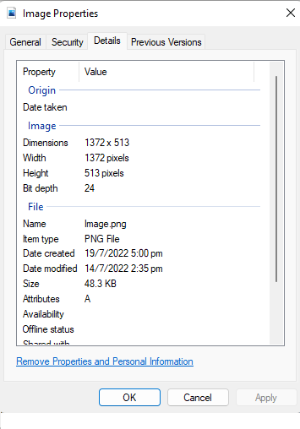
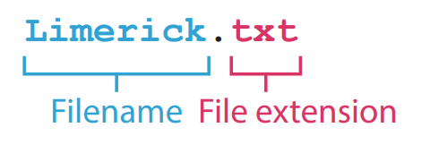
Multimedia
3.5
Multimedia can be stored in various file formats.
The file format and the metadata of a file are usually stored in its file header.
The file format of a file is usually indicated by its file extension.

Slide 106
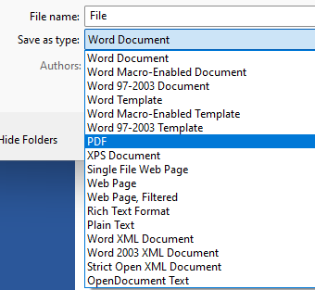
Multimedia
3.5
File formats can be changed by:
Exporting in another file format with editing software
Using file format converting software

Slide 107
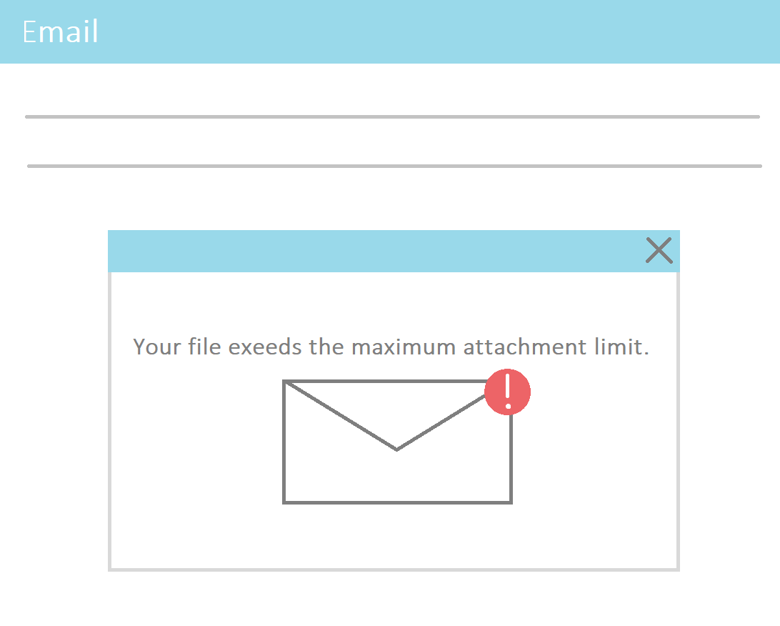
Compression
3.5
Files are often compressed to facilitate file transmission and save storage space.
Details of compression method are usually stored in the file header.

Slide 108
Compression
3.5
There are mainly two types of compressions:
Lossless Compression | Lossy compression
No data lost after compression | Some data lost after compression
Original file can be retrieved completely | File slightly different after decompression
Saves less storage space | Saves more storage space

Slide 109
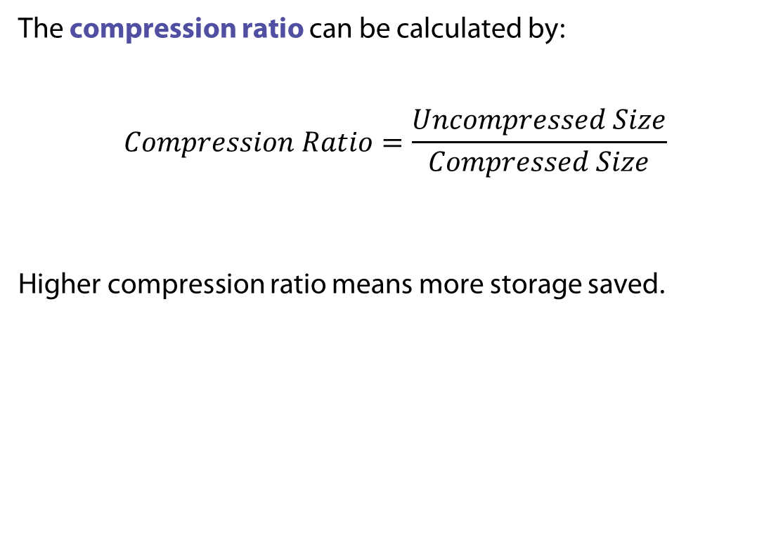
Compression
3.5
The compression ratio can be calculated by:
$$Compression Ratio=\frac{Uncompressed Size}{Compressed Size}$$
Higher compression ratio means more storage saved.

Slide 110
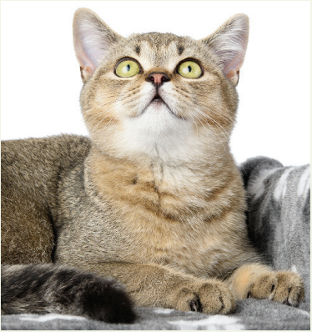
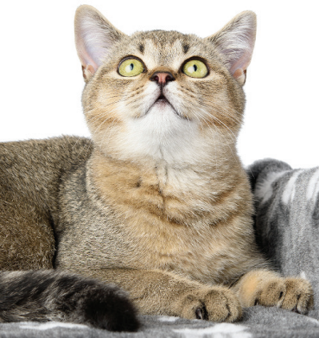
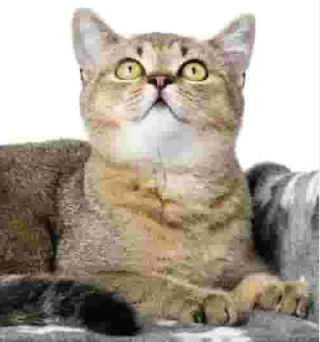
3.1
Finish Activity 3.1 on P. 103 of the textbook.
File format | BMP | PNG | JPG
Compression | Uncompressed | Lossless | Lossy
Image
File size | 1376 KB | 609 KB | 5 KB
Compression ratio |  | 1376 KB / 609 KB = 2.26 | 1376 KB / 5 KB = 275

Slide 111
3.1
BMP and PNG
BMP

Slide 112
3.2
Study and compare the two images on P. 104.

Slide 113


3.2
File format | BMP | JPG
Compression | Uncompressed | Lossy
Image
File size | 1 MB | 1 MB
Image width | 550 | 1618
Image height | 635 | 1871
File size after compressing into a ZIP file | 853 KB | 1017 KB
Compression ratio of compressing it into a ZIP file | 1024 ÷ 853 = 1.20 | 1024 ÷ 1017 = 1.01

Slide 114



3.2
JPG uses lossy compression, it can store a larger image at the same file size as BMP.
Compressing a BMP image usually save more storage space than JPG images as JPG images are already compressed.
BMP
JPG

Slide 115
Text
A
There are two types of text:
Plain text
Formatted text

Slide 116

Text
A
Plain Text
Stores characters only
File size smaller than formatted text
Plain text file is approximately: file size per character × number of characters

Slide 117

Text
A
Formatted Text
Stores characters and formatting data (e.g. font type, font size, font colour)
File size larger than plain text

Slide 118
Text
A
Common text file formats include:
File format | Type | Remarks
TXT | Plain text | Relatively small file size. Widely supported by different operating systems.
DOC/DOCX | Formatted text | Native to Microsoft Word. Contain multimedia, including images, audio, videos and hyperlinks.
PDF | Formatted text | Native to Adobe Acrobat, but is usually exported from other file formats. Contain multimedia, including images, audios, videos and hyperlinks. Provides consistent document layout and text format across different devices as well as operating systems, i.e. it is cross-platform.

Slide 119
3.7
Which of the following documents should be stored in the format of PDF instead of DOCX?
Academic certificate
Template of a management report
Instruction manual containing a table of contents
(1) only
(2) only
(1) and (3) only
(2) and (3) only

Slide 120
3.7
Analysis
For item (1), PDF format provides a consistent document layout, which allows academic certificates to retain their authentic appearance on any devices and identical hard copies can be printed.
For item (2), the template of a management report is expected to be copied and edited multiple times. Its layout is not finalised as its contents are missing. DOCX format is better for editing. The report should only be exported as a PDF file after it is finished.
For item (3), PDF format provides a consistent document layout and also ensures that the text and image in the instruction manual will not be misplaced on any devices. If any of its contents is misplaced, the page number may change, invalidating its table of contents.
Solution
The answer is C.

Slide 121
3.7
Finish Checkpoint 3.7 on P. 108.
D
D

Slide 122


Image
B
There are two types of images:
Bitmap images
Vector images

Slide 123

Image
B
Bitmap images
Stored as a series of squares (pixels).
Can be edited by common image editing software. (e.g. Microsoft Paint)
File size of an uncompressed bitmap image file: colour depth × resolution

Slide 124

Image
B
Vector images
Stored as mathematical formulae
Smaller file size
Do not have rough edges, do not lose quality when scaled up or down.

Slide 125




Image
B
Colour depth is the number of bits used to represent the colour of a pixel.
Images with higher colour depth can include more colours.
1-bit colour | 3-bit grayscale | 3-bit colour | 8-bit colour

Slide 126


Image
B
Resolution is the total number of pixels in an image. It is usually presented as “no. of pixels per row × no. of pixels per column”.
Images with higher resolution will look less blurry.
High-resolution image | Low-resolution image

Slide 127



Image
B
Aspect Ratio is the ratio of width to height.
Changing the aspect ratio of an image will result in blank spaces or cropping.
Original image | Image with blank spaces | Cropped image

Slide 128


3.3
Compare the two screens on P. 112.
16:9 monitor | 4:3 monitor

Slide 129
3.3
High aspect ratio results in wider screen, which is usually good for gaming. In this example, 16:9 monitor makes it easier for the player to spot the purple enemy.

Slide 130


Image
B
Transparency means that whether an image can allow transparent areas or not.
Transparent | Not Transparent

Slide 131


Image
B
Common image file formats include:
File format | Type | Support transparency | Support animation | Compression
BMP | Bitmap |  |  | Uncompressed
JPEG/ JPG | Bitmap |  |  | Lossy
GIF | Bitmap |  |  | Lossless
PNG | Bitmap |  |  | Lossless
WebP | Bitmap |  |  | Lossless or Lossy
TIFF/TIF | Bitmap |  |  | Lossless
SVG | Vector |  |  | Uncompressed

Slide 132
3.9
Finish Lab 3.9 on P. 114 of the textbook. File size (in MB) =
24 bits × 1,024 × 768 = 3 bytes × 1,024 × 768 = 3 KB × 768 ≈ 2,304 KB = (2,304 ÷ 1,024) MB ≈ 2.25 MB
Colour depth | 24 bits
Resolution | 1024 × 768

Slide 133
3.8
Read the following paragraph and answer questions 1 and 2. Henry took some photos during his journey. He wants to upload these photos to his social media account.
Which of the following image file formats is suitable for him to upload?
TIFF
SVG
GIF
PNG

Slide 134
3.8
Analysis
TIFF is not widely supported by web browsers. Vector images are drawings that can be represented by mathematical formulae. Real life photos are better not stored as vector images. Thus, SVG is not suitable. For non-animated images, PNG is better than GIF due to its capability of having higher colour depth and higher compression ratio.
Solution
The answer is D.

Slide 135
3.8
Henry decides to upload his photo in JPG format instead. Which of the following is/are the benefit(s) of his decision?
JPG file has a relatively smaller size.
JPG file uses lossless compression.
JPG supports animation.
(1) only
(2) only
(1) and (3) only
(2) and (3) only

Slide 136
3.8
Analysis
JPG uses lossy compression and thus its file size is relatively smaller. Among all the mentioned file formats, only GIF supports animation.
Solution
The answer is A.

Slide 137
3.8
Finish Checkpoint 3.8 on P. 115 of the textbook.
B

Slide 138
Audio
C
An audio file has three attributes:
Bit depth
Sampling rate
Number of channels

Slide 139


Audio
C
Bit depth is the number of bits used to represent an audio sample.
Sampling with a high bit depth
Sampling with a low bit depth

Slide 140


Audio
C
Sampling rate is the number of audio samples taken per second.
Sampling with a high bit depth
Sampling with a low bit depth

Slide 141

Audio
C
An audio file can contain more than one channel. For example:
Stereo (2 channels)
5.1 surround sound (6 channels)
File size of an uncompressed audio file:
Bit depth × number of channels × sampling rate × duration

Slide 142
Audio
C
Common audio file formats include:
File format | Compression | Remarks
WAV/WAVE | Uncompressed | High audio quality. Relatively large file size.
MP3, AAC, OGG | Lossy | Relatively small file size.
FLAC, ALAC | Loseless | High audio quality. Relatively large file size.

Slide 143
3.10
Finish Lab 3.10 on P. 119 of the textbook. File size (in MB) =
16 bits × 2 × 96,000 × (60 × 2 + 30) = 4 bytes × 96,000 × 150 = (57,600,000 ÷ 1,024) KB = (56,250 ÷ 1,024) MB ≈ 54.9 MB
Bit depth | 16 bits
Number of channel(s) | 2
Sampling rate | 96,000 Hz
Duration | 2 minutes and 30 seconds

Slide 144
3.9
John wants to upload his song to his personal website. However, the storage space of his website is limited. Which audio format should he choose?
MP3
AVI
WAV
WMV

Slide 145
3.9
Analysis
AVI and WMV are not audio file formats. WAV is an uncompressed file format, while MP3 is a compressed file format. Thus, MP3 has a relatively smaller file size.
Solution
The answer is A.

Slide 146
3.9
Finish Checkpoint 3.9 on P. 119 of the textbook.
Advantage: WAV has a higher audio quality.
Disadvantage: WAV has a larger file size.

Slide 147
Video
D
Videos are sequences of images shown within a certain duration. It may contain audio track(s).
A video file has four attributes:
Colour depth
Resolution
Frame rate
Duration

Slide 148

Video
D
Frame rate is the number of frames shown per second.
It is measured in fps (frame per second).

Slide 149

Video
D
The colour depth and resolution of a frame are similar to that of an image.
File size of an uncompressed video file:
colour depth × resolution × frame rate × duration + size of the audio track

Slide 150
Video
D
Common video file formats include:
File format | Codec | Browser support | File size | Features and applications
MP4 | MPEG-4 | Most | Relatively small with high compression rate | Video streaming
 | H.264 (AVC) | Most | Smaller than MPEG-4 | Live streaming HD and Full HD video streaming
 | H.265 (HEVC) | Few | Smaller than H.264 | Live streaming Better image quality for streaming videos with a resolution above 2K
WebM | VP8 | Most latest versions | Smaller than H.264 with higher compression rate | Video streaming Live streaming

Slide 151
3.11
Finish Lab 3.11 on P. 121 of the textbook.
File size (in GB) =
16 bits × 640 × 360 × 24 × (60 × 60) = 2 bytes × 640 × 360 × 24 × 3600 = (39,813,120,000 ÷ 1,0243) GB ≈ 37.1 GB
Bit depth | 16 bits
Resolution | 640 × 360
Frame rate | 24 fps
Duration | 1 hour

Slide 152
3.10
Fanny has four files, the file sizes of which are all 20 MB. She compresses them to ZIP files. Which of the compressed files has the smallest file size under normal circumstances?
 | Original files | Compressed files
A. | A.png | A.zip
B. | B.jpg | B.zip
C. | C.wav | C.zip
D. | D.wmv | D.zip

Slide 153
3.10
Analysis
Compressing a compressed file saves less storage space than compressing an uncompressed file. Among all four files, only C.wav has an uncompressed file format.
Solution
The answer is C.

Slide 154
3.10
Finish Checkpoint 3.10 on P. 122 of the textbook.
Advantage: MP4 has a relatively smaller file size. Disadvantage: AVI has better video quality.
C

